Slide 1
Agenda
Psychological Research
Research Designs
Ethics & Considerations
Scientific Experiments
The Replication Crisis

Slide 2
Psychological Research

Slide 3
The Science of Psychology
What makes psychology a science?
  We collect evidence that we can repeatedly measure to build knowledge on the reasons (cognitive or physiological) behind behavior
What makes approaching psychology as a science difficult?
  We can observe and measure behavior, but we cannot directly observe or measure the mind
Why is it important that psychology is a science rather than an opinion-based debate? What consequences might there be if we didn’t treat psychology as a science?

Slide 4
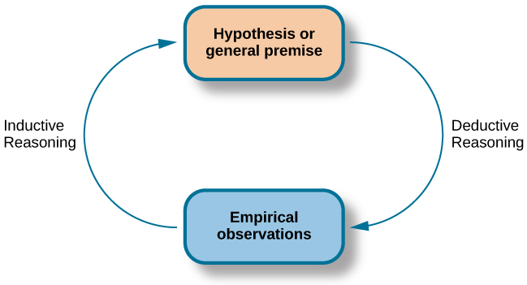
Types of Reasoning
Deductive reasoning: Start with a rule, apply it to a specific case
  Ex: All triangles have 3 sides -> this shape has 3 sides -> this is a triangle
Inductive reasoning: Start with observations, create a rule to explain them
  Ex: 3 friends like books by SJM & 2 coworkers like books by SJM -> SJM’s books must be good

Slide 5
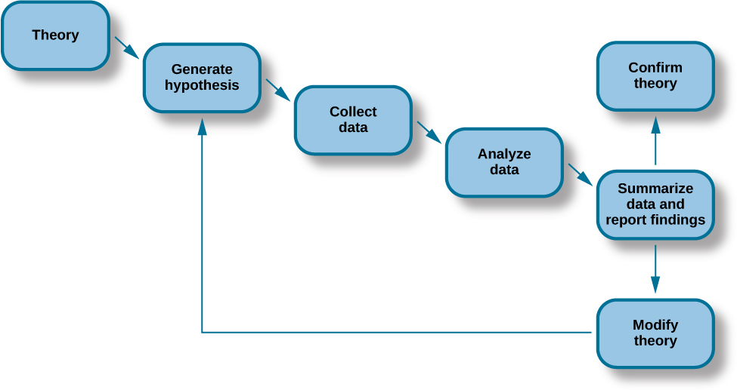
The Scientific Process
Theory: a well-developed set of ideas that propose an explanation for observed phenomena
Hypothesis: a testable prediction about our idea, usually presented as an if-then statement

Slide 6
Scientific Experiments

Slide 7
Conducting an Experiment
Step 1
Make your predictions (hypotheses)
Step 2
Define your variables and how you will measure them
Step 3
Design the experiment and how you will avoid biases
Step 4
Gather your participants
Step 5
Collect and analyze the data
Step 6
Report your results

Slide 8
Creating the Hypotheses
Null hypothesis: the hypothesis stating that there is no relationship between variables
  Consider this hypothesis ground zero
  Ex: “Sleep does not improve mood ratings”
Alternative hypothesis: the alternative to the null; the hypothesis stating that there is a relationship
  Ex: “Sleep increases ratings on a mood scale” (Short version)
What makes a good hypothesis?
  It is testable/ measurable
  It is clear and concise
Bad Alternative Hypothesis: “College students are more stressed”
Good Alternative Hypothesis: “College students will score at least 10 points higher on the Perceived Stress Scale than individuals of the same age in the work force.”

Slide 9
Defining the Variables
Independent variable: the variable manipulated or controlled by the experimenter
Dependent variable: the variable that is impacted by the independent variable. This is the variable you will measure.
Operational definition: the specific description of what each variable is, and specifically how you can measure it
One way of manipulating independent variables to look for a relationship is to split the participants into two groups:
  Experimental group: receives the treatment being test
  Control group: does not receive the treatment (sometimes receives a placebo)
Quasi-experiment: when a participant is separated into a group based on a characteristic, rather than by assignment (e.g., smoker versus non-smokers)

Slide 10
Designing the Experiment
Are you interested in differences between groups, change over time, or both?
How can you control one variable while measuring changes in the other?
Are there any other variables that could drive the changes you’re predicting?
Where will the study take place? Who will be there to help?
What materials will you need?
How will you gather participants? What are the inclusion/ exclusion criteria?
What analyses will you run? What are your cut-offs for if there was a change?
What results do you plan to report?

Slide 11
Considerations When Designing the Experiment
Experimenter bias: the researcher’s expectations skewing the results of the study
Placebo effect: when someone’s expectations determine their experience rather than being an impact of the variable
What are some designs that can help mitigate possible problems?
Single-blind study: the researcher knows which group each participant is in, but the participant does not
Double-blind study: both the researcher and the participants are blind to group assignments

Slide 12
Gathering Participants
It is important that the sample of participants adequately represents the population and its variety of characteristics. How can the researcher insure this happens?
  Random sampling: selecting individuals at random so all differences have an equal chance of being selected
It is also important that the researcher does not incorrectly arrive at a conclusion by filling groups in a way that would force the desired results (e.g., putting the entire math team in one group when the test is supposed to be comparing algebra grades between face-to-face and online attendance). How do we prevent this?
  Random assignment: randomly assigning participants to each group, so there is an equal chance of being in either group

Slide 13
Collecting & Analyzing Results
Once the design is complete, you can start collecting data. After you have reached your goal number of participants, you will stop the experiment and analyze your data.
Were there any differences between your groups, indicating an impact from the independent variable? What are the chances that difference would have happened by accident?
  Typically, most psychology researchers only allow a 5% chance of a false positive

Slide 14
Reporting Results
After completion of the experiment, the researcher can write a paper on their experiment with all the details necessary for someone else to be able to repeat the experiment by following the paper’s instructions. What good could repeating an experiment accomplish?
  Reliability: the ability to consistently get the same results
  Validity: the accuracy of the results
The researcher’s paper is submitted to a peer-reviewed journal where experts in the field can provide feedback before the paper is finally published
  Peer-reviewed journal article: article read by several other scientists (usually anonymously) with expertise in the subject matter, who provide feedback regarding the quality of the manuscript before it is accepted for publication

Slide 15
But Wait…
This process was explained to look at cause-and-effect. What if we want to see if things change in relation to one another instead?
Then we look at correlations!

Slide 16
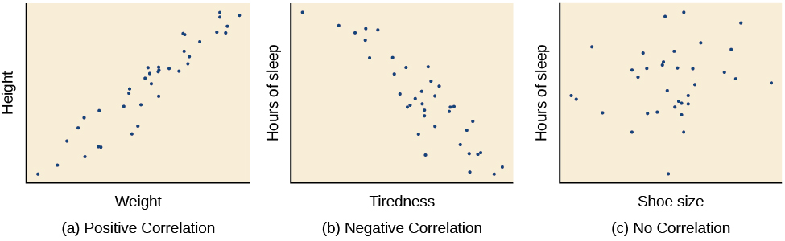
Correlation at a Glance

Slide 17
Measuring Correlation
As a reminder, correlation is a pattern in data where a change in one variable relates to a change in the second variable
We measure correlation with the correlation coefficient (usually represented by r)
The correlation coefficient is measured on a scale from -1 to +1
  A positive r represents a relationship where an increase in one variable correlates with an increase in the second variable
  A negative r represents a relationship where an increase in one variable correlates with a decrease in the second variable
  Scores closer to one (positive or negative) represent a stronger relationship, whereas scores closer to zero represent a weak relationship

Slide 18
Limitations of a Correlation Study
Correlation DOES NOT EQUAL causation
  Just because there is a trend between two variables, it does not mean that one variable causes the other to occur
Confounding variable: a separate factor that causes the relationship between two variables
  For example, while there may be a correlation between the time of day and the amount a mother yells, the confounding variable is the teenager refusing to get out of bed
Illusory correlations: false correlations, where people incorrectly believe a relationship exists
  For example, believing that the phase of the moon determines human behavior
Confirmation bias: only believing information (even false information) that confirms a preconceived notion, and ignoring contradicting information
  For example, Johnny believing that Jane must like him because she talked to him in the hallway, ignoring that she was annoyed with him

Slide 19
Research Designs

Slide 20
Correlational vs Experimental Designs
Correlational Research
Measures two or more variables, looking for trends or patterns
Ex: Observing that there is a trend that as the temperature rises, so does ice cream consumption
Experimental Research
Measures at least one variable, while manipulating another variable (or variables)
Ex: A researcher gives caffeine to one group of rats while giving another group of rats a placebo, then measures how long each group spends running on a wheel

Slide 21
Case Studies
Important Terms:
Generalizing: applying information gained from a study to other people in the population. For example, a study looking at the impact of drinking water could make the generalization that drinking water has health benefits for everyone.
Example | Pros | Cons
H.M. (Henry Molaison) underwent a brain surgery for epilepsy but developed severe amnesia afterwards. As a result, H.M. was incapable of adding new information to his long-term memory. | -LOTS of detailed information | -Low ability to generalize to the rest of the population

Slide 22
Naturalistic Observation
Important Terms:
Observer bias: the unconscious skewing of data in favor of the results the research project is hoping to find
Inter-rater reliability: an accountability measure that reduces observer bias by pursuing consistency between multiple observers
Example | Pros | Cons
Hidden camera in a room; Watching wild animals with binoculars | -Very accurate representation of “real world” phenomena -Can generalize to normal population well | -Very difficult to achieve without subjects realizing they are being studied -Very difficult to control (you may spend hours watching and still never see the behavior in question) -Requires lots of time, money, and luck

Slide 23
Survey
Important Terms:
Population: the group of people a researcher is interested in studying (e.g., college students)
Sample: a subset of people from the population that the researcher can actually collect data from (e.g., a class of PSY 203 students at UNK)
Example | Pros | Cons
-Family Feud -Customer satisfaction surveys | -Easier to get a large sample size that more accurately reflects diversity in the population -Typically, a cost-efficient method | -Less depth of information -People can (and do) lie

Slide 24
Archival Research
Important Note:
Archival data refers to any pre-existing data. It can be 6 days old or 600 years old
Example | Pros | Cons
Pulling old student records to find patterns between course load, major, number of Q-drops, and GPA | -Less time and money | -No control over what information was originally collected -There may be inconsistencies between different sources, and some sources may not have collected all the categories you are interested in

Slide 25
Longitudinal Research
Important Note:
Longitudinal research can be correlation, experimental, or both
Example | Pros | Cons
Monitoring the reading skills of a group of children from preschool through college | -Shows the development between each time the individuals are retested | -Extremely time-consuming and expensive -Participants may drop out of the study/ lose contact with the researcher

Slide 26
Cross-Sectional Research
Important Terms:
Cohort: a group of people sharing a certain characteristic experience (e.g., a generation)
Example | Pros | Cons
Comparing the opinions on same-sex marriage between different generations | -Can be less of a time investment than longitudinal studies (some cross-sectional studies are longitudinal though) | -Differences may be due to social or environmental factors one group experienced, rather than a difference between ages

Slide 27
Ethics & Considerations

Slide 28
Ethical Oversight to Prevent Ethical Oversight
An institutional review board (IRB) must assess the possible harm to any participants before an experiment can begin, and the research can only proceed with the IRB’s approval.
Similarly, an Institutional Animal Care and Use Committee (IACUC) reviews any cases involving animals, to ensure ethical standards are maintained.
There are a variety of procedures and paperwork in place to protect participants.
  Informed consent
  Debriefing (especially when deception is involved)
Unfortunately, a lot of protections in place now are a direct result of unethical choices in the past

Slide 29
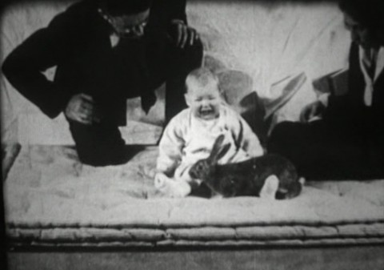
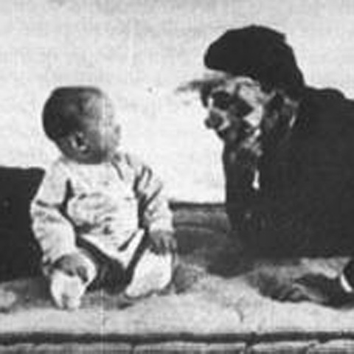
Little Albert

Slide 30
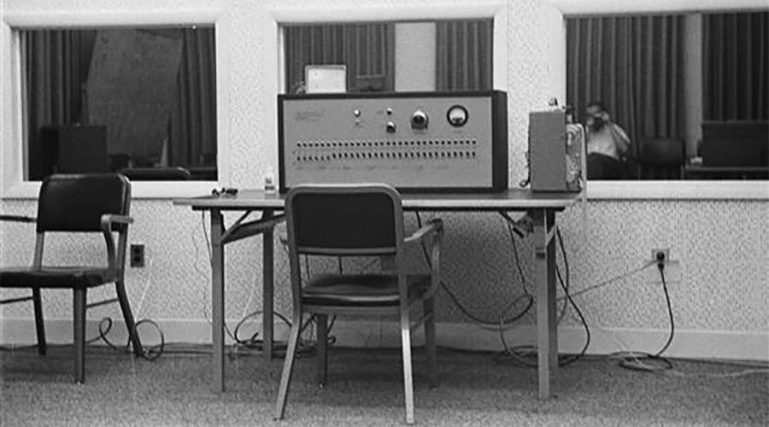
The Milgram Study
  Prod 1: Please continue. or Please go on.
  Prod 2: The experiment requires that you continue.
  Prod 3: It is absolutely essential that you continue.
  Prod 4: You have no other choice, you must go on.

Slide 31
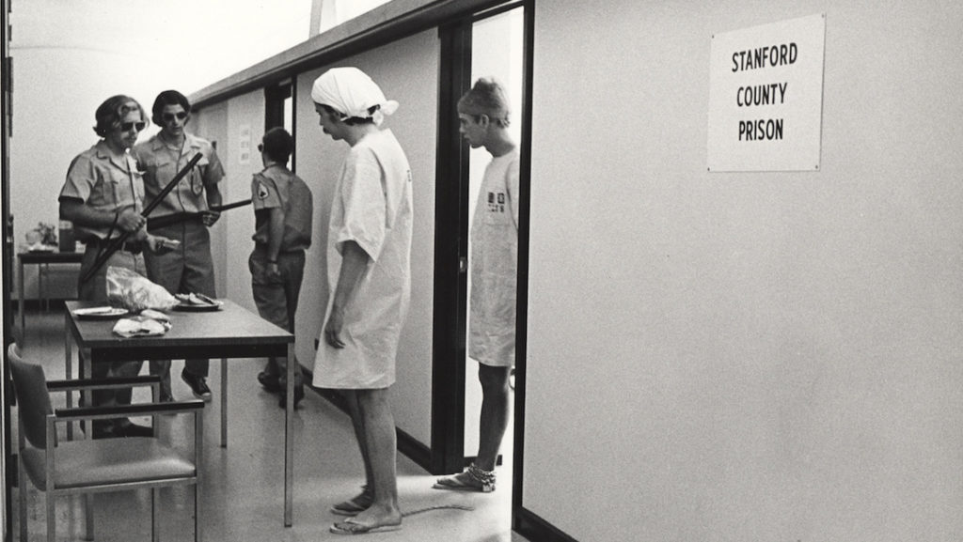
The Stanford Prison Experiment
If you’re curious, there’s a 2015 movie enacting this experiment available for free on CW (just search “The Stanford Prison Experiment” on CW website). Warning: It is rated R

Slide 32
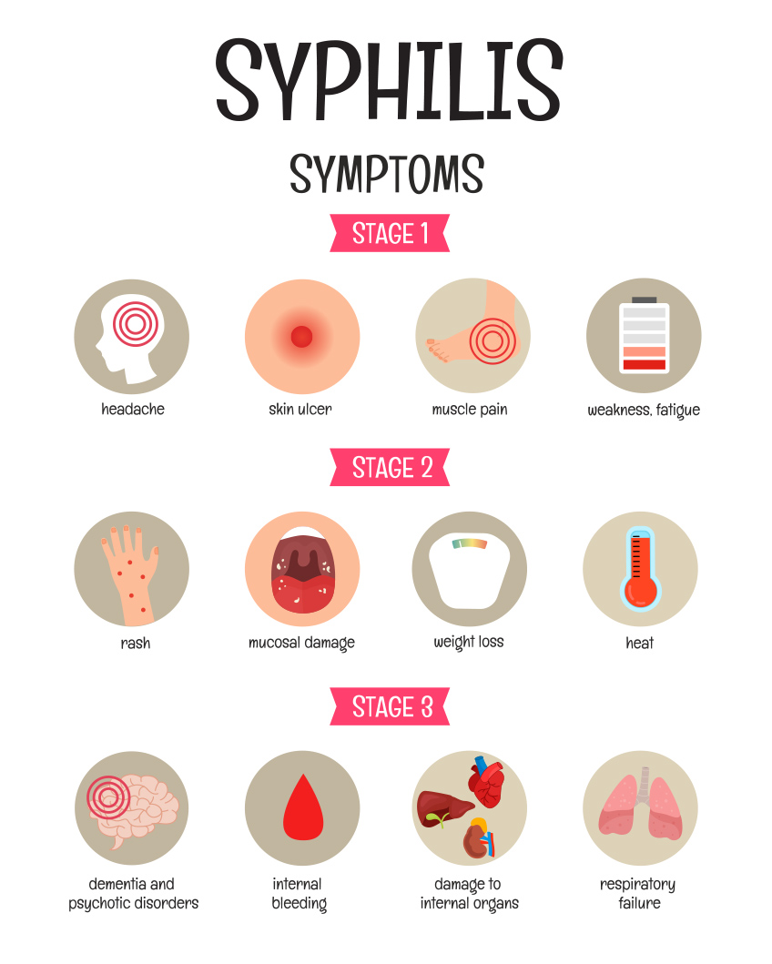
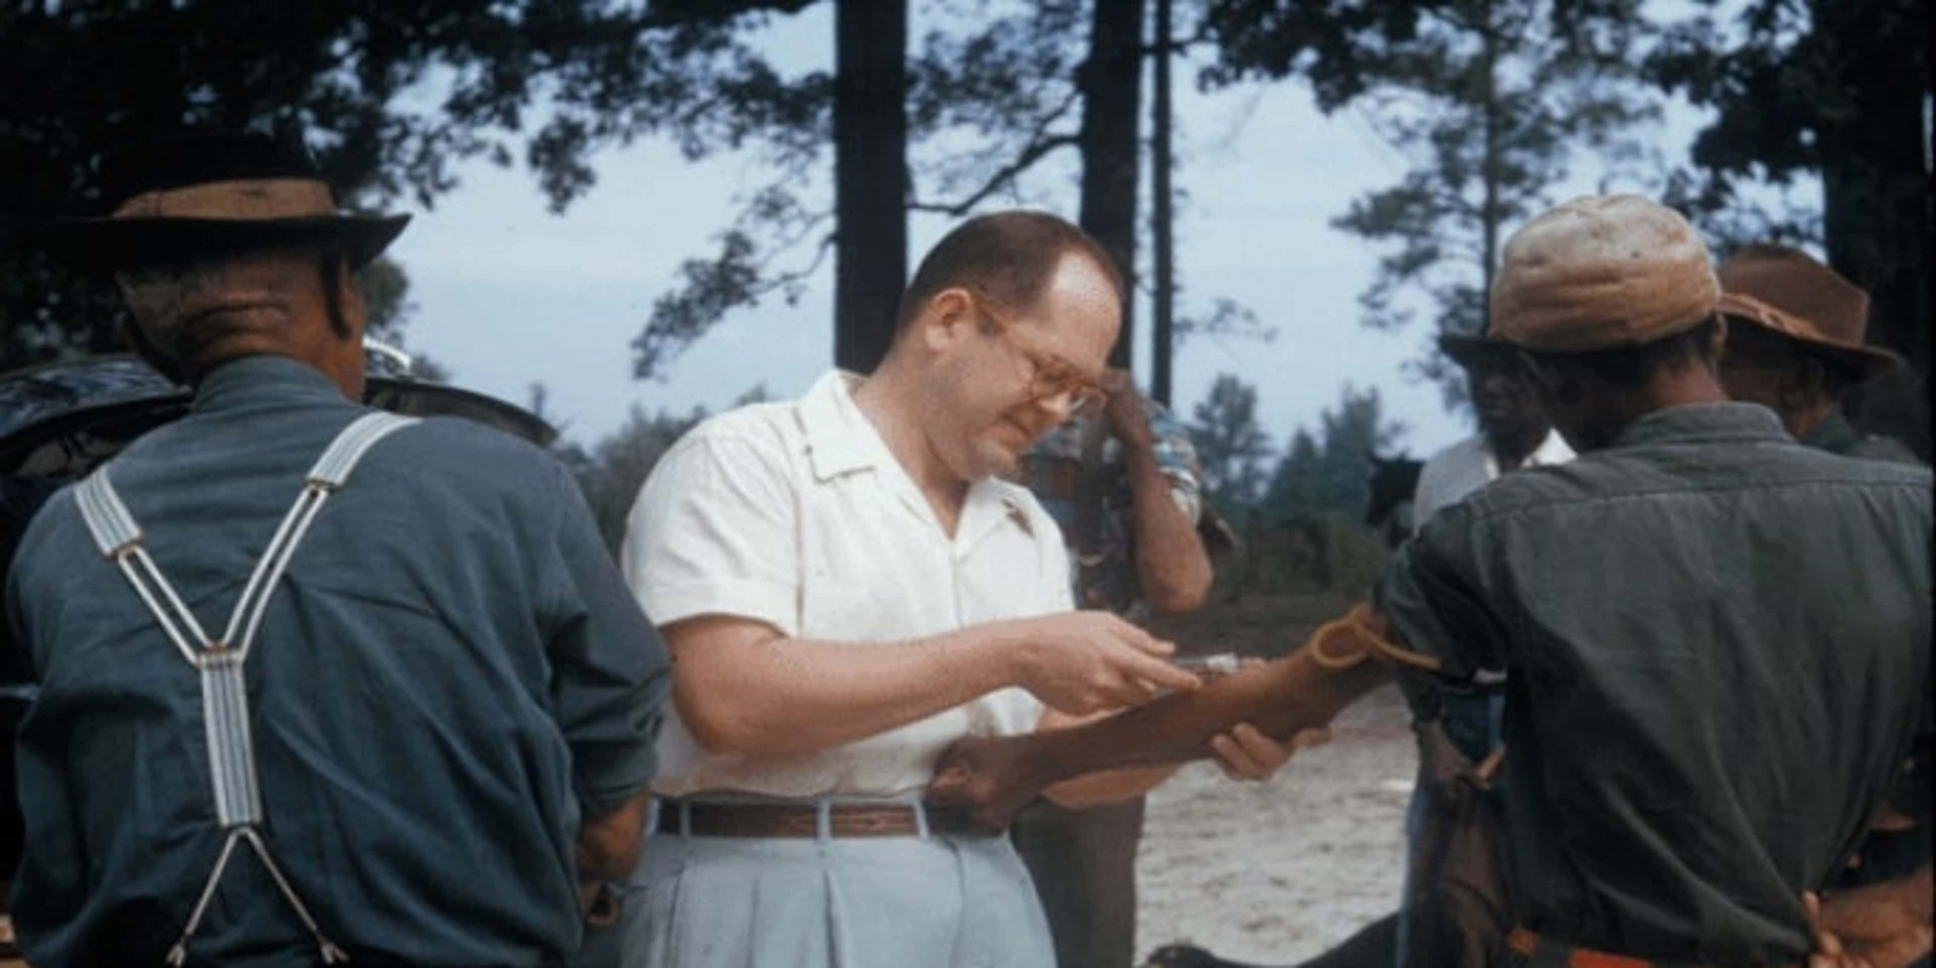
The Tuskegee Syphilis Experiment

Slide 33
The Belmont Report
Published April 1979
Three Key Principles:
  Beneficence: do no harm, maximize benefits and minimize risks
  Respect for Persons: Individuals participating in research do so voluntarily without coercion.
    Consent Forms
  Justice: Equal distribution of burdens and benefits of research. Recruit participants that are relevant to the research rather than convenient.

Slide 34
The Replication Crisis
A field-wide overhaul due to concerns around research studies that could not be replicated
Largely spurred by Cornell psychologist Daryl Bem publishing a study on extrasensory perception (ESP), leading to field-wide backlash
Multiple contributing factors
  Publication bias & file drawer effect
  “Publish or perish”
  Poor designs/ statistical analyses
  Questionable research practices (QRPs)
Spurred the push for Open Science practices

Slide 35
Next Time on PSY 203…
Before Next Class:
Take the syllabus quiz
  Due 1/22
Complete the Introduction Sheet
  Due 1/22
Read Chapter 3 and Take Quiz
  Due 1/27 at 2 pm
Next Class:
Discussing Chapter 3- Biopsychology

